Slide 1
Marion Military Institute Residential Network

Slide 2
About Apogee
Work exclusively in higher education
01
Partner with over 400 campuses
02
Connectivity and Student Experience is our priority
03

Slide 3
3 KEYS
Get Connected
1
Manage Devices
2
Get Support
3
Notes:
Points to Cover:
Share context of why Apogee is here in ways that resonate for the Housing and that they care about the student experience and listen to feedback
# of devices that are being brought to campus continues to increase each year; the overall Wi-Fi needs have shifted
You all know this better than anyone; today’s student is streaming video, doing homework online, watching and posting videos, etc;
Being a higher education and student experience focused company, we see ourselves as an extension of the University… With the Housing/Res Life team- it means we help create an at home experience in terms of the internet service and support. As an extension of campus IT, it means we are delivering top notch equipment and service to support the student residents

Slide 4
SERVICE LEVEL
Wired and Wireless service in residential halls
100mbps download
50mbps upload
Per device guaranteed up to 7 devices per student simultaneously
An experienced field support technician

Slide 5
2 SSIDs
MyResNet-5G
For 5 GHz devices
If you are able to see this network, you will want to connect to it.
MyResNet-2G
For 2.4Ghz devices.
If you have a 2.4Ghz device, this will be the only network that you see.
Notes:
Points to Cover:
Share context of why Apogee is here in ways that resonate for the Housing and that they care about the student experience and listen to feedback
# of devices that are being brought to campus continues to increase each year; the overall Wi-Fi needs have shifted
You all know this better than anyone; today’s student is streaming video, doing homework online, watching and posting videos, etc;
Being a higher education and student experience focused company, we see ourselves as an extension of the University… With the Housing/Res Life team- it means we help create an at home experience in terms of the internet service and support. As an extension of campus IT, it means we are delivering top notch equipment and service to support the student residents

Slide 6
Get Connected
HOW DO I GET ONLINE WITH A LAPTOP PHONE OR TABLET?
Enter the default wireless password: internet
Next log in with your MMI username and password
From there, create your personal wireless password and enter your contact information.
You’ll then need to “forget” the MyResNet-5G or MyResNet-2G on your device
Lastly-reconnect to MyResNet-5G or MyResNet-2g using your new personal wireless password.

Slide 7
HOW DO I GET ONLINE WITH A GAMING CONSOLE OR OTHER DEVICE?
Connect
Connect to MyResNet-5G or MyResNet-2G
Open
Open a web browser and go to myresnet.com
Log
Log into your account and select “devices”
Enter
Enter the MAC address or Wi-Fi address of the device and select “Add”
Connect
Connect your device to MyResNet-5G or MyResNet-2G with your password

Slide 8
MAC Randomization
MAC Definition:
A MAC address is a hardware identification number that uniquely identifies each device on a network.
To communicate with a Wi-Fi network, a device must identify itself to the network using a unique network address called a media access control (MAC) address.
MAC Randomization:
A MAC address that randomly changes each time it joins a new Wi-Fi network

Slide 9
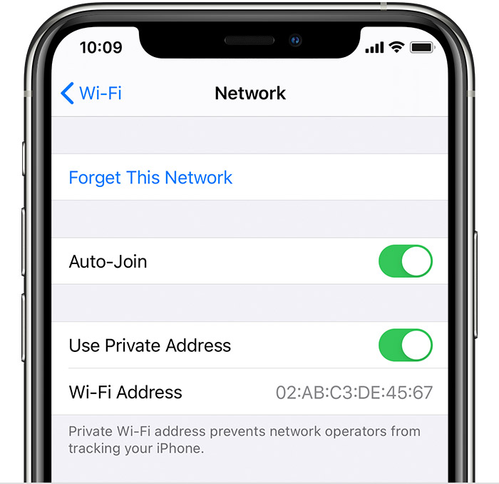
Apple Turning off MAC Randomization/Private Addresses
iPhone, iPad, or iPod touch – IOS 14
Open the Settings app, then tap Wi-Fi.
Tap the information button next to a network.
Tap Use Private Address to off position. If your device joined the network without using a private address, a privacy warning explains why.
The new setting is used the next time your device joins the network. If you want to use it immediately, turn Wi-Fi off and back on in Control Center or Settings, then join the network.

Slide 10
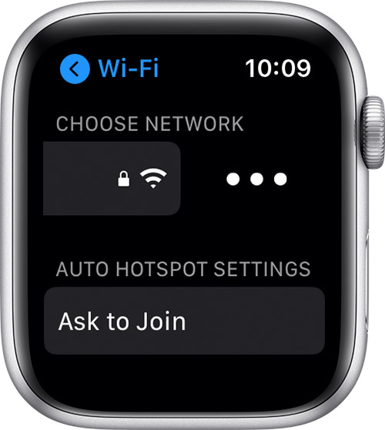
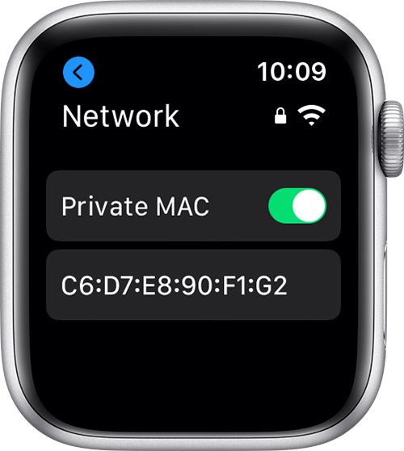
Apple Watch Turning off MAC Randomization/Private Addresses
Apple Watch OS 7
Open the Settings app, then tap Wi-Fi.
Tap the name of the network you joined. If you haven't joined the network yet, swipe left on its name and tap more
Tap Private MAC to off position
The new setting is used the next time your Apple Watch joins the network. If you want to use it immediately, turn Wi-Fi off and back on in Control Center or Settings, then join the network.

Slide 11
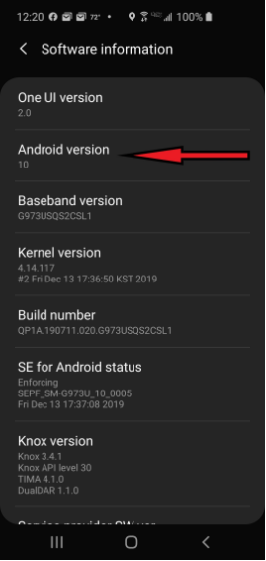
Android 10+ Turning off MAC Randomization/Private Addresses
Android Version 10+
Confirm Firmware Version:
From the home screen, swipe down from the top of the screen
Tap the Settings Icon (typically looks like a gear)
Tap About Device -or- About Phone
Tap Software Information
Look for Android Version near the top of the page
MAC Randomization Applies to Android v10 and Above

Slide 12
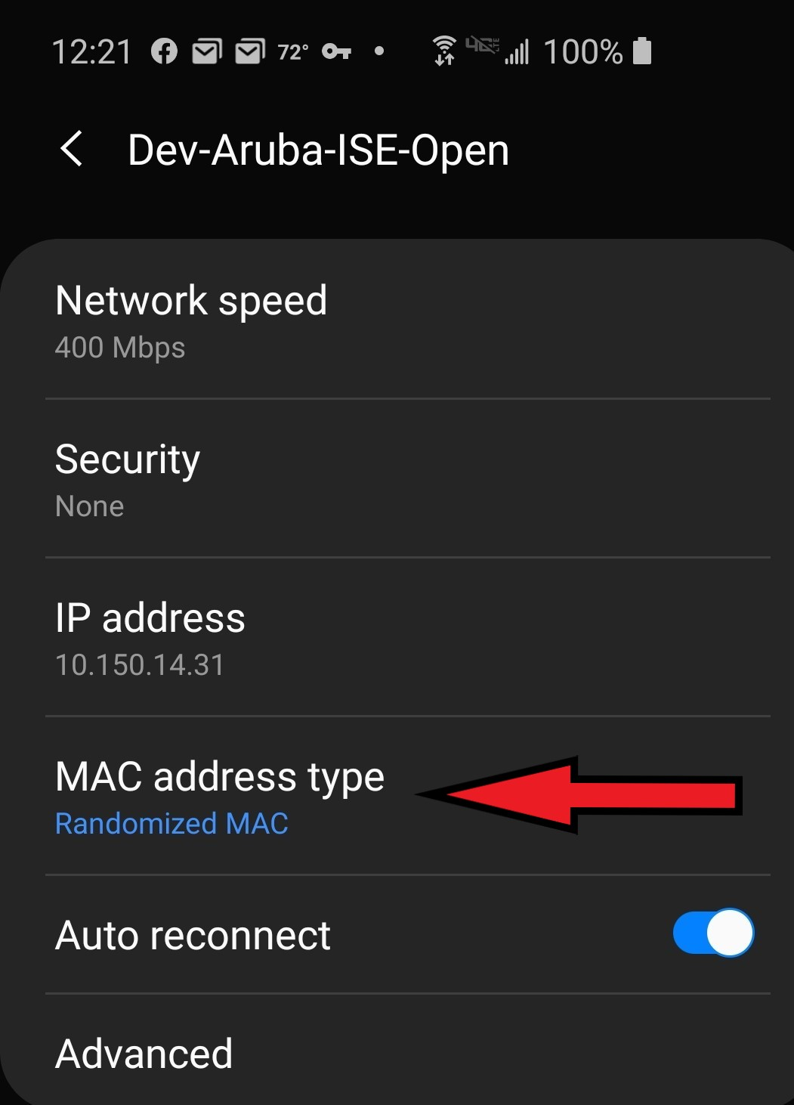
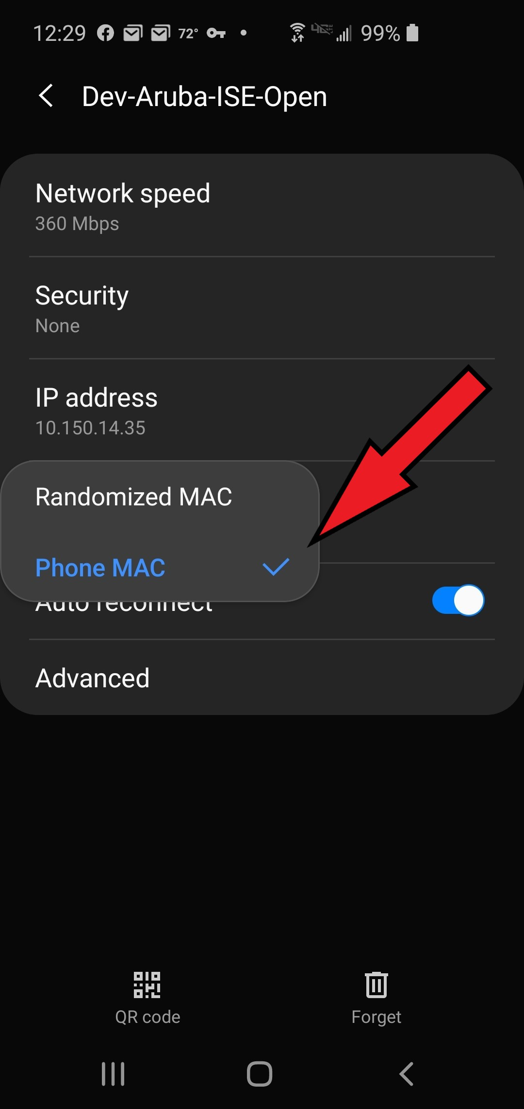
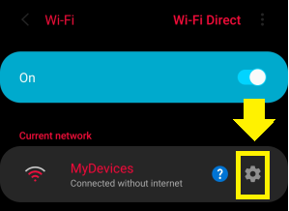
Turning off MAC Randomization/Private Addresses
2
3
1
Android v10 and Above:
From the home screen, swipe down from the top of the screen
Press and hold the Wi-Fi icon until network list opens
Confirm device is connected to our SSID
Tap the Settings Icon (typically looks like a gear)
In the MAC Address Type, select Phone MAC

Slide 13
Apogee Resources for MAC Randomization
Android Knowledge Base
https://apogee.service-now.com/nav_to.do?uri=%2Fkb_view.do%3Fsysparm_article%3DKB0010537%26sysparm_rank%3D1%26sysparm_tsqueryId%3D8d4c26591b1a581054c6206ebd4bcb52
Apple Support Page
https://support.apple.com/en-us/HT211227
FAQ’s
https://myresnet.com/support

Slide 14
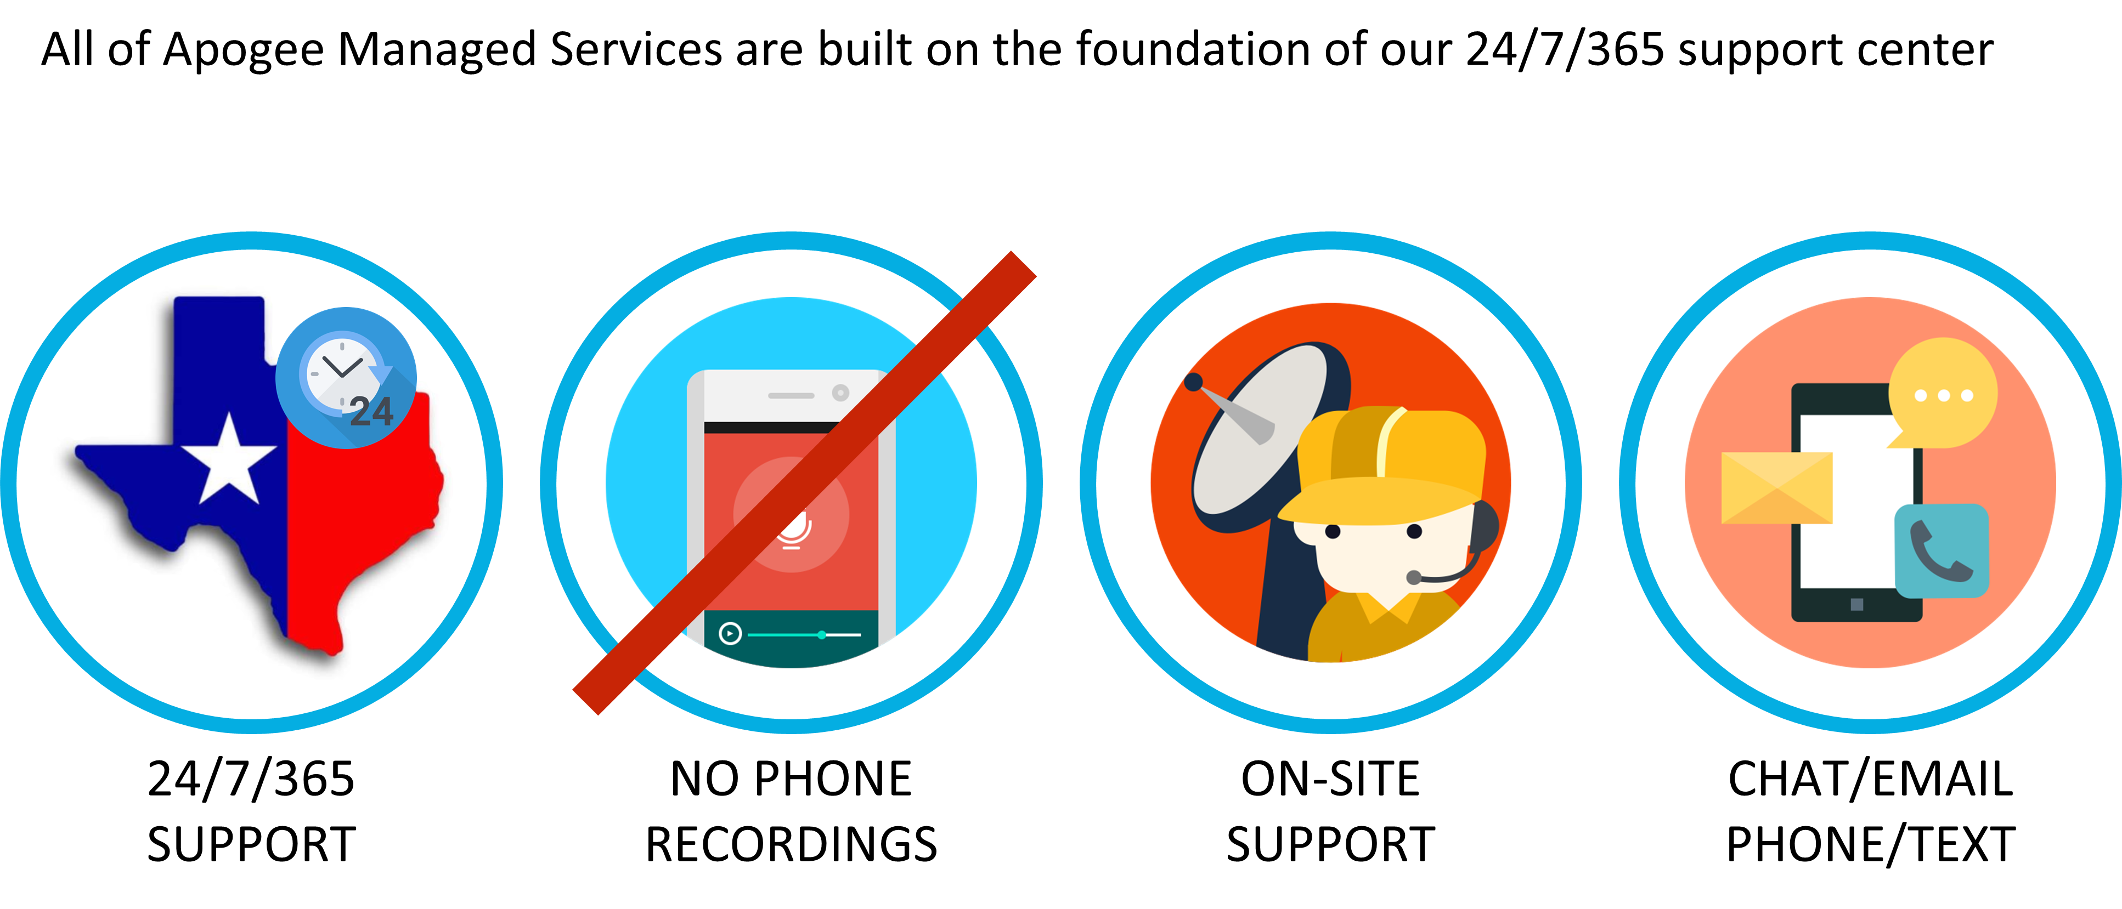
Support

Slide 15
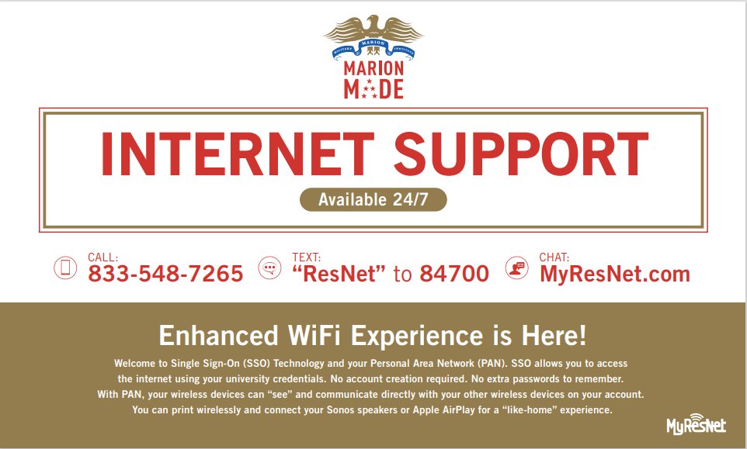
Communications

